Slide 2
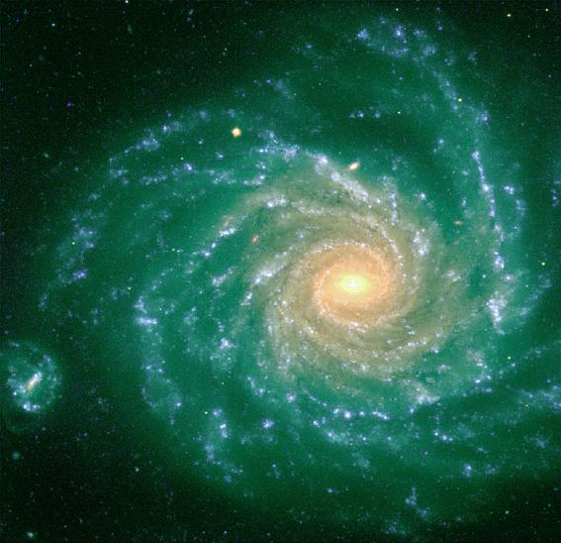
Stellar orbits change through
interactions with inhomogeneities
of gravitational potential
(molecular clouds,
spiral arms, bar)
Resonant interactions at corotation may induce
radial mixing of stars
far beyond
what is expected from
simple epicyclic motion

Slide 3
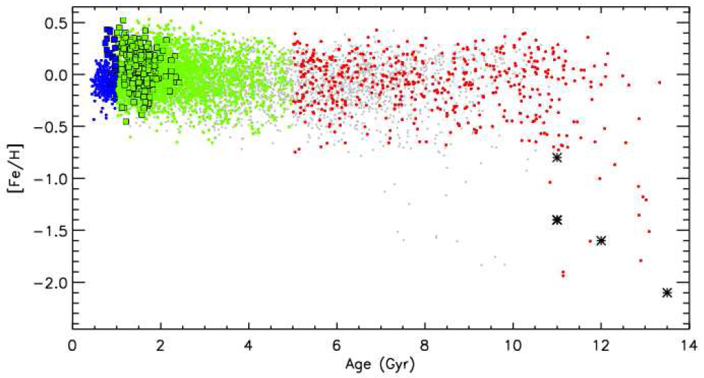
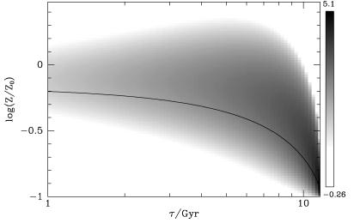
EFFECT OF TRANSIENT SPIRALS
(Sellwood and Binney 2002)
Stars just inside corotation swap places with those just outside it;
Radial migration (churning) without heating radially the disk
It can « naturally » explain (assuming a disk metallicity gradient)
the observed dispersion in local age-metallicity relation
Casagrande et al. 2011
Sellwood and Binney 2002

Slide 4
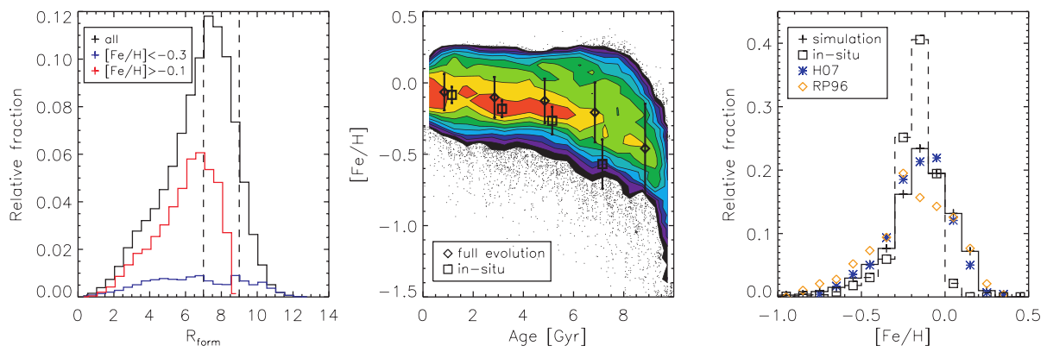
Impact of radial migration on local disk (Roskar et al. 2008, N-body+SPH)
Fraction of stars now present
In Solar neighborhood, but
born in other places of the disk
Only 50% born in situ !
This impacts the
Age-metallicity relation
Making it flatter and
more dispersed
And the local
Metallicity distribution
Making it broader
What if the Sun has migrated from the inner
(higher than local metallicity) MW disk ?

Slide 5
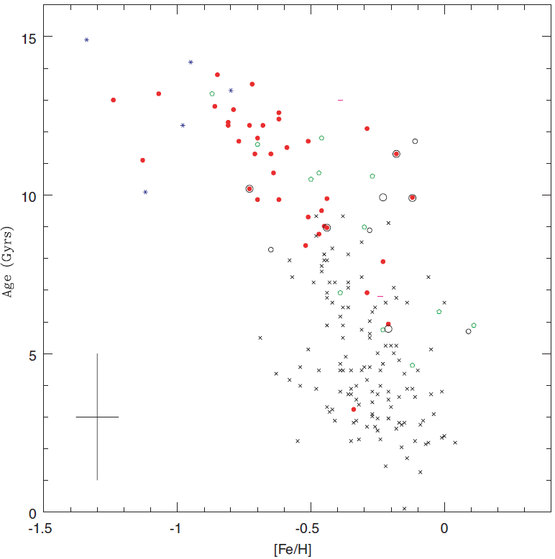
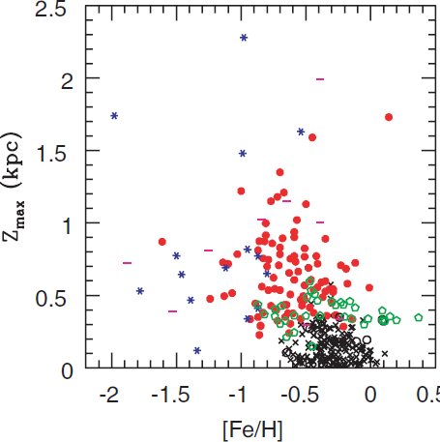
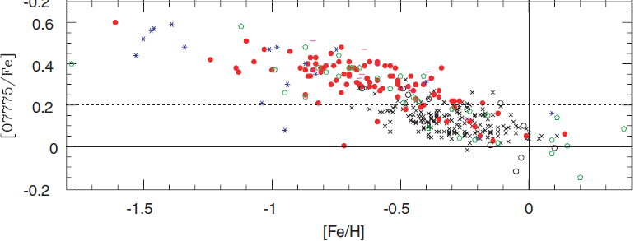
Thick
Thin
Data: Reddy et al. 2006
The issue of the thick disk
Old (>9 Gyr) stars,
away from the plane
having higher O/Fe ratio
than thin disk stars
of the same metallicity

Slide 6
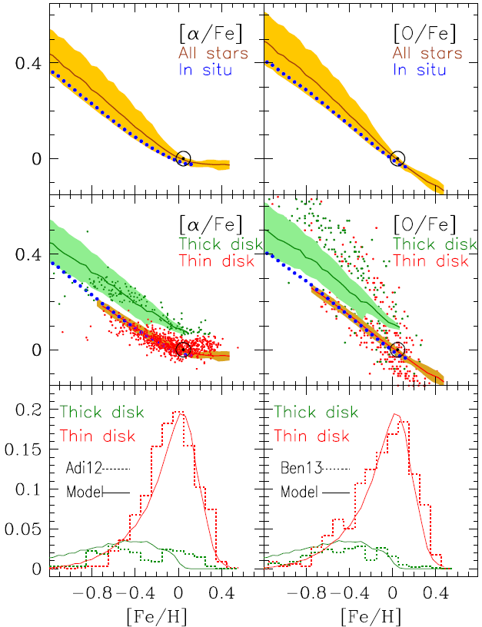
Data: Adibekyan et al. 2011
Data: Bensby et al. 2014
Assuming that
the thick disk is
the old disk (>9 Gyr)
we recover the
[a/Fe] vs Fe/H behaviour
and the
metallicity distributions
of both
the thick and thin disks

Slide 7
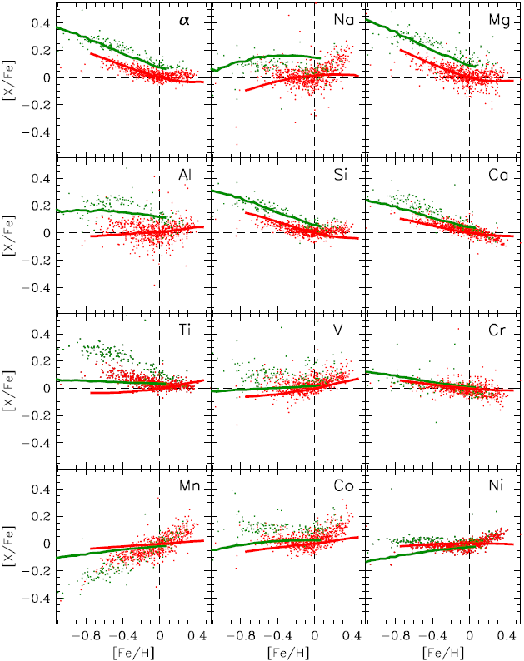
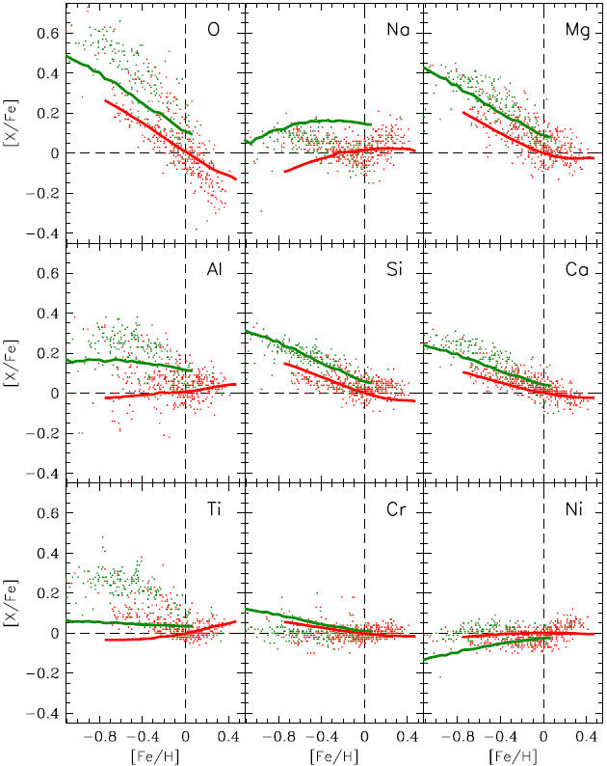
Evolution of thin (<9 Gyr) and thick (>9 Gyr) disks
with yields NORMALISED to solar for AVERAGE LOCAL (8 kpc) STAR 4.5 Gyr old
Data: Adibekyan et al. 2011
Data: Bensby et al. 2014

Slide 8
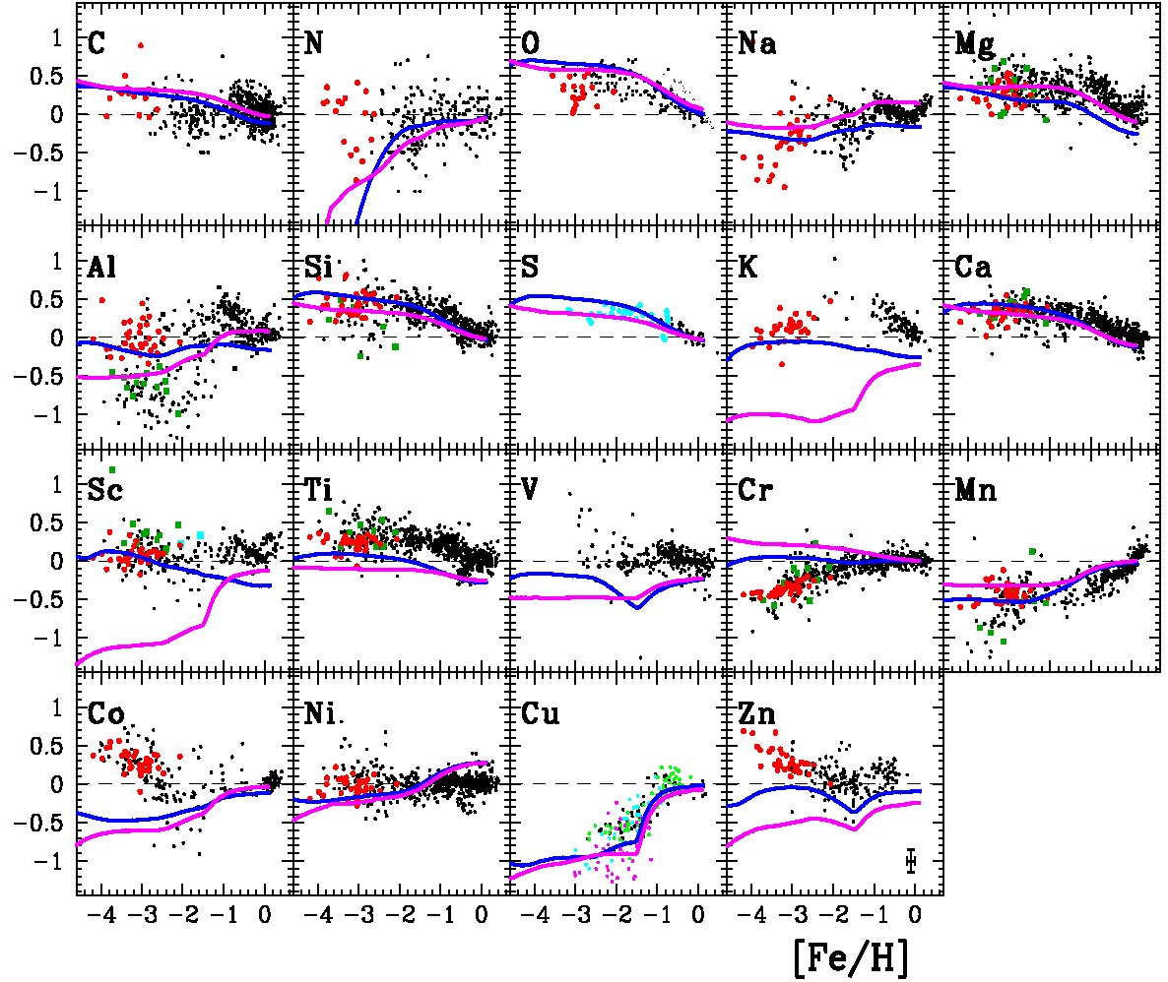
Chemical evolution from C to Zn : theory vs observations
Woosley-Weaver 95
Chieffi-Limongi 04
ALSO
Van den Hoek and
Groenewegen 1997
for IMS and
Iwamoto et al 1997
for SNIa

Slide 9
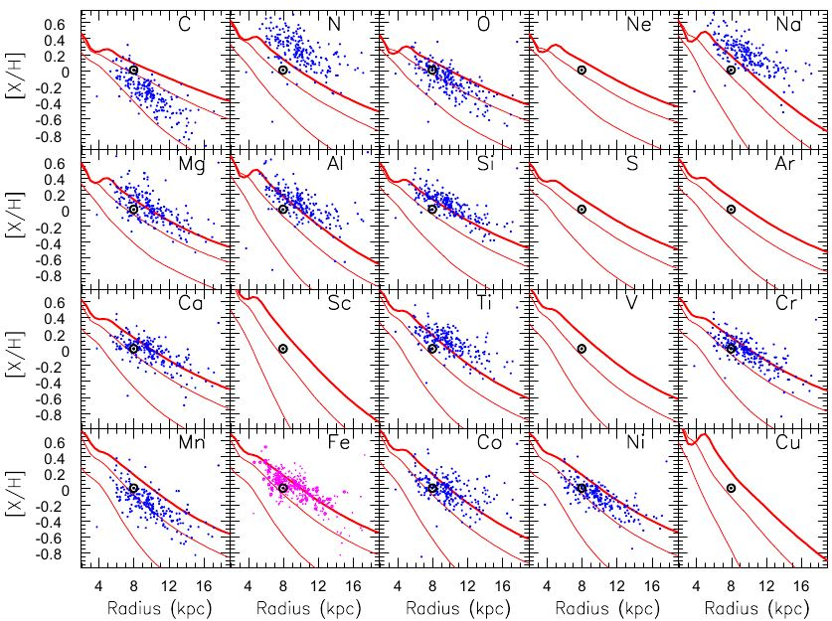
Abundance profiles in Cepheids

Slide 10
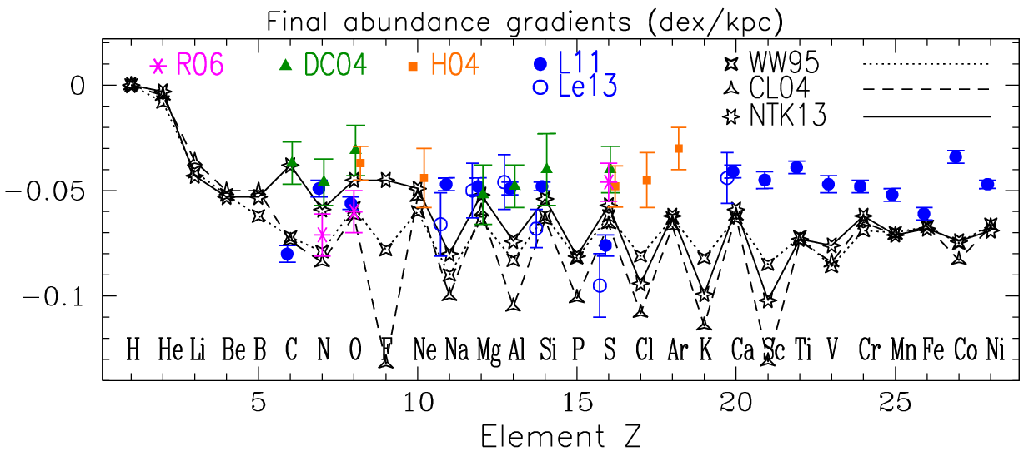
H-II
B-stars
PlanNeb
Cepheids
An odd-even effect should be seen in the gradients;
But it does not seem to be there….

Slide 11
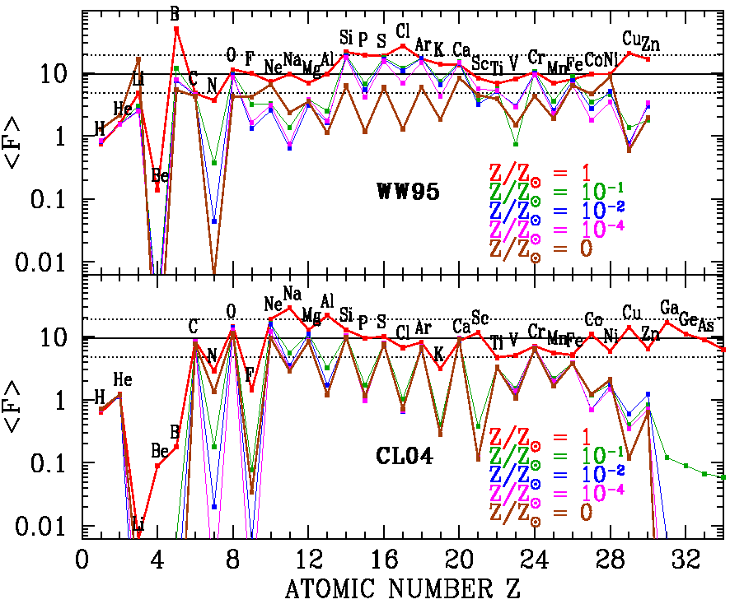
Yields of massive stars (overproduction factors w.r.t. solar, averaged over a normal IMF)
Woosley-Weaver 1995
12 – 40 Mʘ stars
Chieffi – Limongi 2004
13 – 35 Mʘ stars

Slide 12
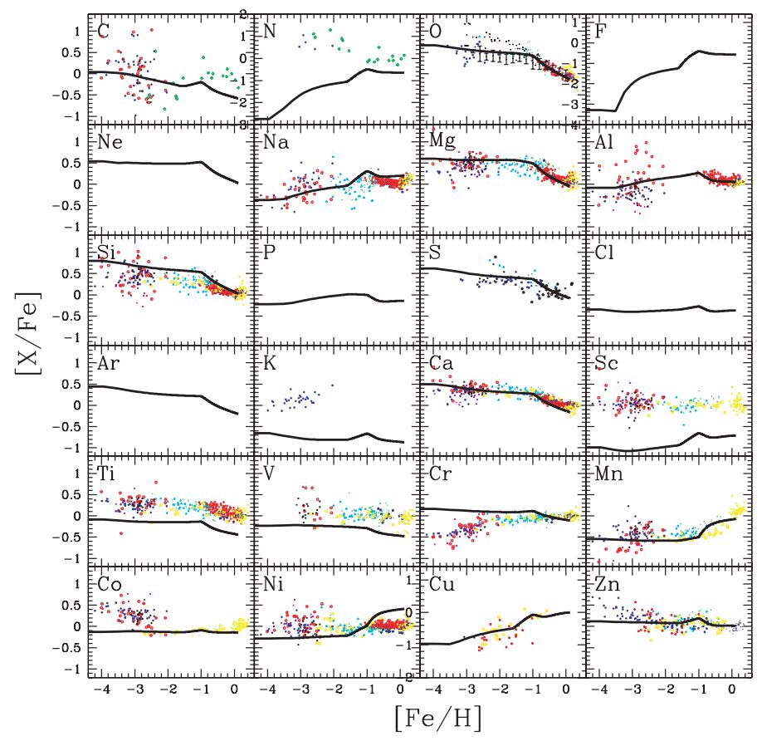
Kobayashi et al. 2006

Slide 13
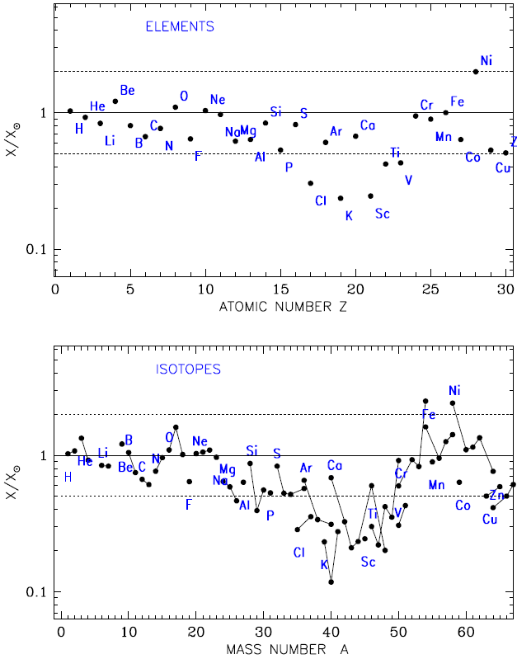
The yields of
Nomoto et al. 2013
have
some problems
in the region
P to V

